Slide 1
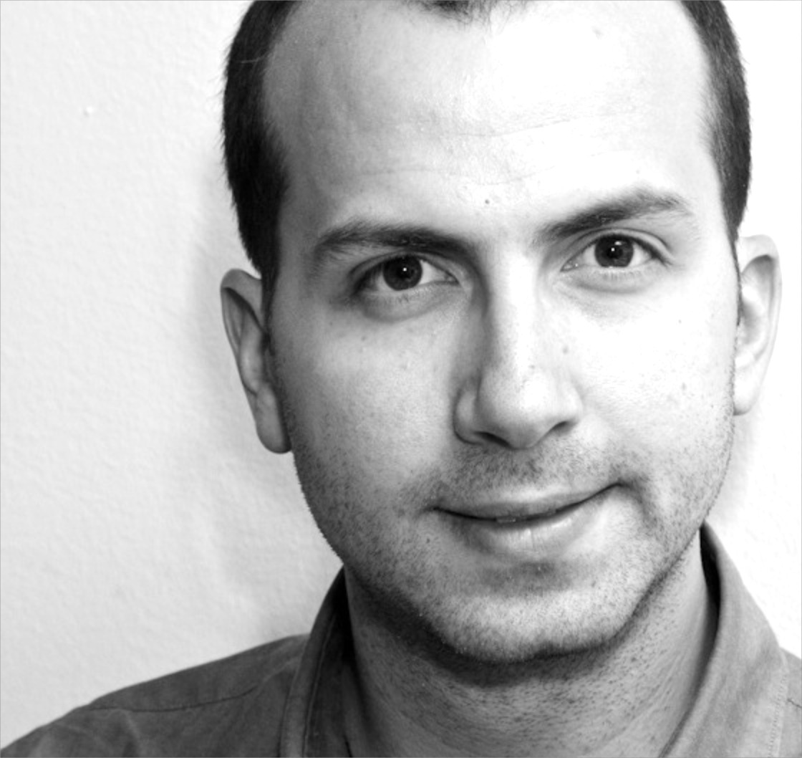
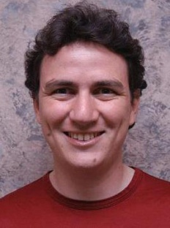
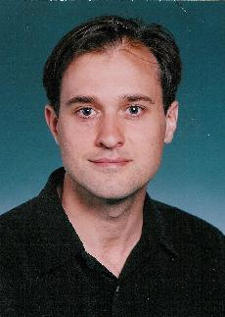
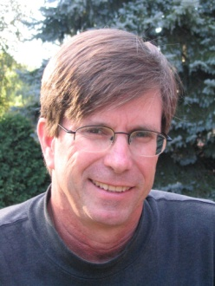

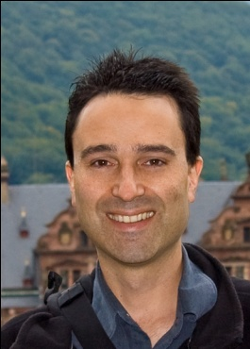
Parallel and Distributed Systems for Probabilistic Reasoning
Thesis Defense
Joseph E. Gonzalez
Thesis Committee:
Carlos Guestrin
University of Washington & CMU
Guy Blelloch
CMU
David O’Hallaron
CMU
Alex Smola
CMU & Google
Jeff Bilmes
University of
Washington

Slide 2
The foundations of computation have changed …

Slide 3
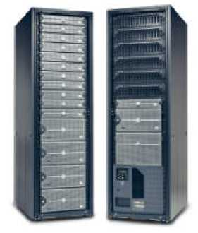
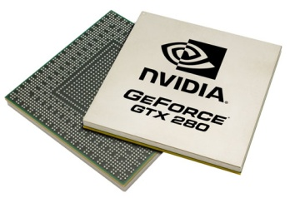
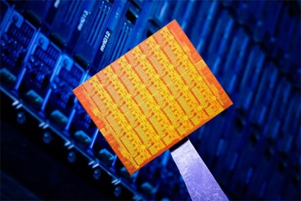
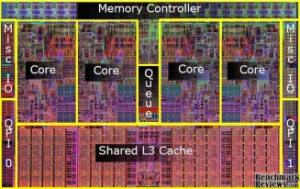

New Parallel and Distributed Platforms
GPUs
Multicore
Clusters
Single Chip
Cloud Computers
Clouds
New Opportunities
Increased processing and storage
New Challenges
Parallel algorithm design and implementation

Slide 4
The scale of machine learning problems is exploding …

Slide 5




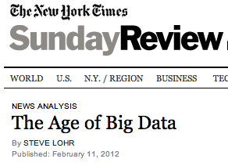
The Age of Big Data
28 Million
Wikipedia Pages
1 Billion
Facebook Users
6 Billion
Flickr Photos
72 Hours a Minute
YouTube
“…growing at 50 percent a year…”
“… data a new class of economic asset, like currency or gold.”
Notes:
- everywhere
- useless -> actionable.
- identify trends, create models, discover patterns. → Machine Learning. Big Learning.

Slide 6
Massive data provides opportunities for structured models…

Slide 7

Example: Estimate Political Bias
?
?
Liberal
Conservative
?
?
?
?
?
?
?
?
Post
?
Post
?
Post
Post
?
Post
Post
Post
Post
?
Post
Post
Post
Post
?
Post
?
Post
?
?
?
?
?
Post
?
Post
Post
Post
Post
Post
Post
?
Post
?
?
?
?
?
?
?
Notes:
Here we have two shoppers. We would like to recommend things for them to buy based on their interests. However we may not have enough information to make informed recommendations by examining their individual histories in isolation.
We can use the rich probabilistic structure to improve the recommendations for individual people.

Slide 8
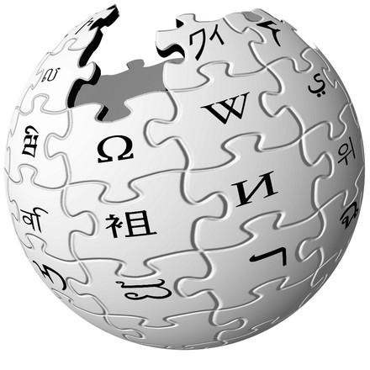


Massive Structured Problems
?
Thesis:
Parallel and Distributed Systems for Probabilistic Reasoning
Advances Parallel Hardware

Slide 9
Thesis Statement: GrAD Methodology
Efficient parallel and distributed systems for probabilistic reasoning:
Graphically decompose computational and statistical dependencies
Asynchronously schedule computation
Dynamically identify and prioritize computation along critical paths

Slide 10
GrAD Methodology: Graphical
Factor statistical and computational dependencies
Improves computational and statistical efficiency
Increases parallelism
Sparse Graph
Independent
Fully Connected
Overly Simplistic
Expressive Tractable Models & Algorithms
Intractable

Slide 11
Synchronous vs. Asynchronous
Synchronous: compute everything in parallel
Highly parallel – Maximum independent work
Highly inefficient – Many wasted cycles
?
?
?
?
?
?
3
3
3
?
+ + = 9
?
?
?
?
?
?
?
?
?
?
?
Post

Slide 12
GrAD Methodology: Asynchronous
Trigger computation as new information arrives
Capture the flow of information:
More efficiently use network and processor resources
Guarantee algorithm correctness
1
1
1
+ + = 3
Post

Slide 13
GrAD Methodology: Dynamic
Dynamically identify and prioritize computation along the critical path
Focus computational resources where most effective:
Accelerated convergence
Increased work efficiency

Slide 14
We apply the GrAD methodology to
Probabilistic Graphical Models
Factor statistical models over a sparse graph
Design parallel and distributed algorithms
Operate on the graphical decomposition
Asynchronously and dynamically schedule computation
Develop systems that support the design and implementation of GrAD algorithms
Parallel and Distributed Algorithms
for Probabilistic Inference
GraphLab & PowerGraph

Slide 15
Massive Structured Problems
Probabilistic Graphical Models
Parallel and Distributed Algorithms
for Probabilistic Inference
GraphLab & PowerGraph
Advances Parallel Hardware

Slide 16



Encode Probabilistic Structure
Probabilistic Graphical Models
Noisy Pixels
True Image
Noisy Picture

Slide 17
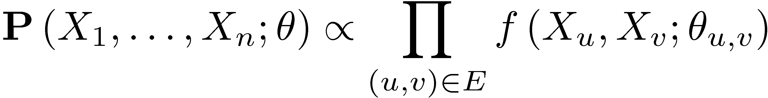
Observed Random Variables
Noisy Pixels
Local Dependencies
Random Variables
True unobserved values
Dependency Graph:
Represent dependencies
Latent Pixel Variables
Parameters:
Characterize probabilities
Joint Probability
Factors
Graph

Slide 18
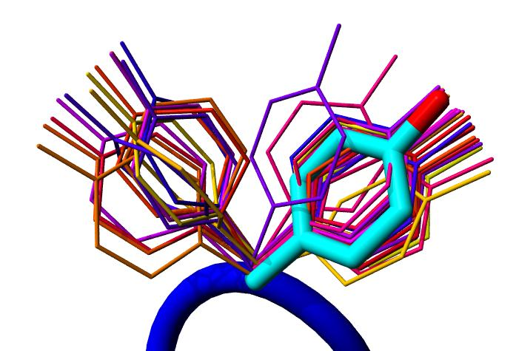

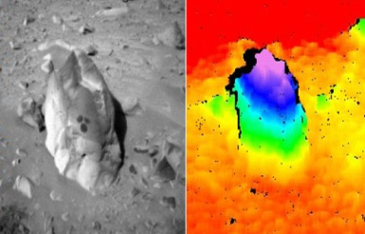
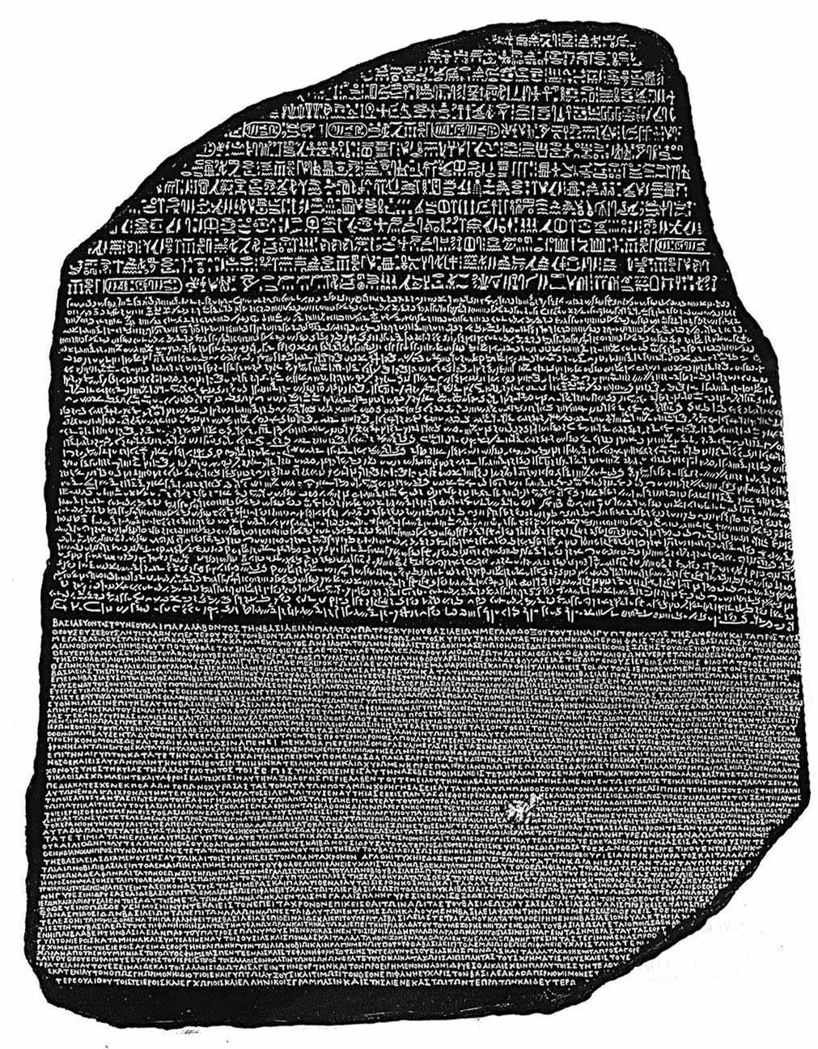
Graphical models provide a common representation
Protein Structure Prediction
Movie Recommendation
Computer
Vision
Machine
Translation
Probabilistic Graphical Models
How are you?

Slide 19
Probabilistic Inference
Making predictions given the model structure and parameters
What is the best
configuration of the
protein side-chains?
Side-Chain
What is the probability
that a particular pixel is black?
Side-Chain
Side-Chain
Protein Backbone
Side-Chain
Side-Chain
NP-complete in general
Focus on approximate methods

Slide 20
Parallel and Distributed Algorithms
for Probabilistic Inference
Belief Propagation
Gibbs Sampling

Slide 21
Parallel Belief Propagation
Joint Work With:
Yucheng Low Carlos Guestrin David O’Hallaron
Published Results
AISTATS’09 UAI’09 Chapter in SUML’10

Slide 22
Loopy Belief Propagation (Loopy BP)
Iteratively estimate the variable beliefs
Read in messages
Updates marginal estimate (belief)
Send updated out messages
Repeat for all variables until convergence
Notes:
Belief propagation is a message passing algorithm in which messages are sent <click> from variable to factor and then <click> from factor to variable and the processes is repeated. At each phase the new messages are computed using the old message from the previous phase leading to a naturally parallel algorithm known as synchronous Belief Propagation.

Slide 23

Synchronous Loopy BP
Often considered embarrassingly parallel
Associate processor with each vertex
Receive all messages
Update all beliefs
Send all messages
Proposed by:
Brunton et al. CRV’06
Mendiburu et al. GECC’07
Kang,et al. LDMTA’10
…
Notes:
Belief propagation is a message passing algorithm in which messages are sent <click> from variable to factor and then <click> from factor to variable and the processes is repeated. At each phase the new messages are computed using the old message from the previous phase leading to a naturally parallel algorithm known as synchronous Belief Propagation.

Slide 24
Is Synchronous Loopy BP an efficient parallel algorithm?

Slide 25
Sequential Computational Structure
Notes:
Consider the following cyclic factor graph. For simplicity lets collapse <click> the factors the edges. Although this model is highly cyclic, hidden in the structure and factors <click> is a sequential path or backbone of strong dependences among the variables. <click>

Slide 26
Hidden Sequential Structure
Notes:
This hidden sequential structure takes the form of the standard chain graphical model. Lets see how the naturally parallel algorithm performs on this chain graphical models <click>.

Slide 27
Hidden Sequential Structure
Evidence
Evidence
Running Time:
Time for a single
parallel iteration
Number of Iterations
Notes:
Suppose we introduce evidence at both ends of the chain. Using 2n processors we can compute one iteration of messages entirely in parallel. However notice that after two iterations of parallel message computations the evidence on opposite ends has only traveled two vertices. It will take n parallel iterations for the evidence to cross the graph.
<click> Therefore, using p processors it will take 2n / p time to complete a single iteration and so it will take 2n^2/p time to compute the exact marginals.
We might now ask “what is the optimal sequential running time on the chain.”

Slide 28
Optimal Sequential Algorithm
Running
Time
Naturally Parallel
2n²/p
Gap
p ≤ 2n
Sequential (Fwd-Bkwd)
2n
p = 1
Optimal Parallel
n
p = 2
Notes:
Using p processors we obtain a running time of 2n^2/p.
Meanwhile <click> using a single processor the optimal message scheduling is the standard Forward-Backward schedule in which we sequentially pass messages forward and then backward along the chain. The running time of this algorithm is 2n, linear in the number of variables.
Surprisingly, for any constant number of processors the naturally parallel algorithm is actually slower than the single processor sequential algorithm. In fact, we need the number of processors to grow linearly with the number of elements to recover the original sequential running time.
Meanwhile, <click> the optimal parallel scheduling for the chain graphical model is to calculate the forward messages on one processor and the backward messages on a second processor resulting in <click> a factor of two speedup over the optimal sequential algorithm.
Unfortunately, we cannot use additional processors to further improve performance without abandoning the belief propagation framework.
However, by introducing slight approximation, we can increase the available parallelism in chain graphical models. <click>

Slide 29
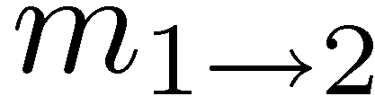
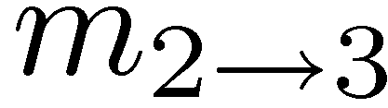
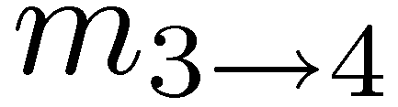
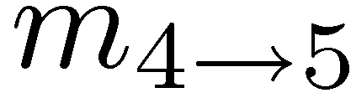
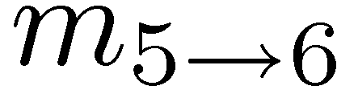
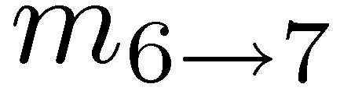
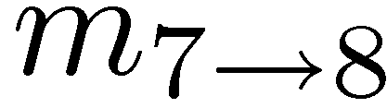
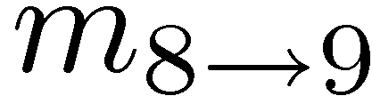
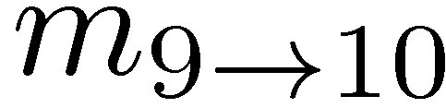
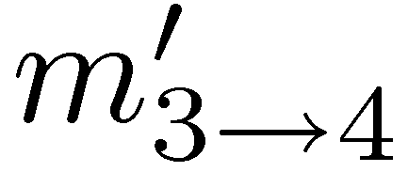
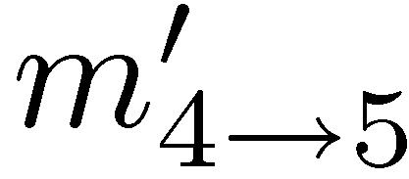
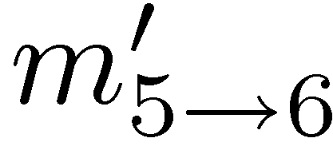
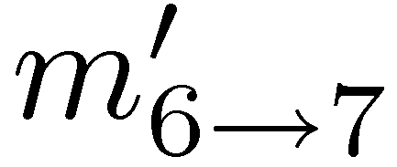
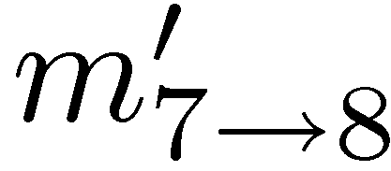
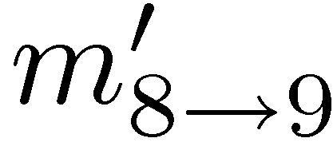
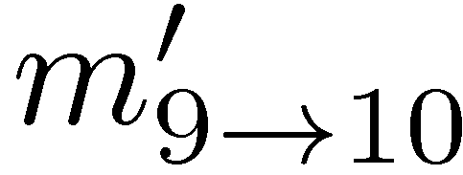
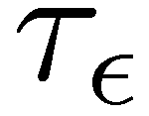
Role of model Parameters on Sequential Sub-Problems
Epsilon
Change
True Messages
1
2
3
4
5
6
7
8
9
10
τ_{ε} -Approximation
τ_{ε} represents the minimal sequential sub-problem
Captures dependence on model parameters
Notes:
Consider <click> the following sequence of messages passed sequentially from vertex 1 to 10 forming a complete forward pass. Suppose instead of sending the correct message from vertex 3 to vertex 4 <click>, I instead send a fixed uniform message from 3 to 4. If I then compute the new forward pass starting at vertex 4 <click> I might find in practice that the message that arrives at 10 <click> is almost identical to the original message. More precisely, for a fixed level of error epsilon there is some effective sequential distance tau-epsilon for which I must sequentially compute messages. Essentially, tau-epsilon represents the length of the hidden sequential structure and is a function of the factors.
Now I present an efficient parallel scheduling which can compute approximate marginals for all variables and for which we obtain greater than a factor of 2 speedup for smaller tau_epsilon.

Slide 30
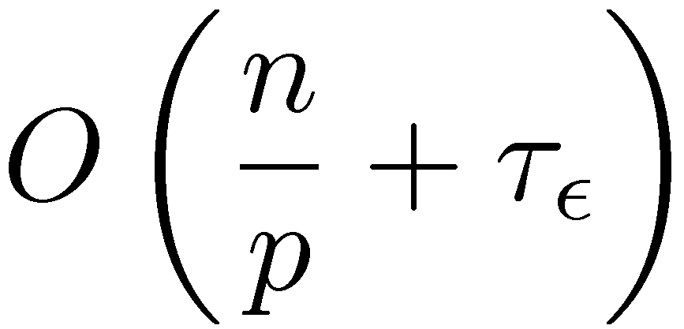
Optimal Parallel Scheduling
Processor 1
Processor 2
Processor 3
Theorem: Using p processors this algorithm achieves a τ_{ε} approximation in time:
and is optimal for chain graphical models.
Parallel
Component
Sequential
Component
Notes:
We begin by evenly partitioning the chain over the processors <click> and selecting a center vertex or root for each partition. Then in parallel each processor sequentially computes messages inward to its center vertex forming forward pass. Then in parallel <click> each processor sequentially computes messages outwards forming the backwards pass. Finally each processor transmits <click> the newly computed boundary messages to the neighboring processors. In AIStats 09 we demonstrated that this algorithm is optimal for any given \epsilon. The running time of this new algorithm <click> isolates the parallel and sequential structure. Finally if we compare the running time of the optimal algorithm with that of the original naturally parallel algorithm <click> we see that the naturally parallel algorithm retains the multiplicative dependence on the hidden sequential component while the optimal algorithm has only an additive dependence on the sequential component.
Now I will show how to generalize this idea to arbitrary cyclic factor graphs in a way that retains optimality for chains.

Slide 31
The Splash Operation
Generalize the optimal chain algorithm: to arbitrary cyclic graphs:
~
Grow a BFS Spanning tree with fixed size
Forward Pass computing all messages at each vertex
Backward Pass computing all messages at each vertex
Notes:
We introduce the Splash operation as a generalization of this parallel forward backward pass.
Given a root <click> we grow <click> a breadth first spanning tree. Then starting at the leaves <click> we pass messages inward to the root in a “forward” pass. Then starting at the root <click> we pass messages outwards in a backwards pass.
It is important to note than when we compute a message from a vertex we also compute all other messages in a procedure we call updating a vertex. This both ensures that we update all edges in the tree and confers several scheduling advantages that we will discuss later.
To make this a parallel algorithm we need a method to select Splash roots in parallel and so provide a parallel scheduling for Splash operations. <click>

Slide 32
Running Parallel Splashes
Local State
Local State
Local State
CPU 1
CPU 2
CPU 3
Splash
Splash
Splash
Partition the graph
Schedule Splashes locally
Transmit the messages along the boundary of the partition
Notes:
The first step to distributing the state is <click> partitioning the factor graph over the processors. Then we must assign messages and computational responsibilities to each processor. Having done that, we then schedule splashes in parallel on each processor automatically transmitting messages along the boundaries each partitions.
Because the partitioning depends on the later elements, we will first discuss the message assignment and splash scheduling and then return to the partitioning of the factor graph.

Slide 33
Priorities Determine the Roots
Use a residual priority queue to select roots:
Splash
Local State
?
?
?
Splash
Priority Queue
CPU 1
Notes:
Show scheduling on a single cpu
Suppose for a moment that we have some method to assign priorities to each vertex in the graph.
Then we can introduce a scheduling <click> over all the factors and variables. Starting with the top elements on the queue <click> we run parallel splashes <click>. Afterward some of vertex priorities will change and so we <click> update the scheduling queue. Then we demote <click> the top vertices and repeat the procedure <click>.
How do we define the priorities of the factors and variables needed to construct this scheduling? <click>

Slide 34
Dynamic Splashes
Priorities adaptively focus computation by determining the shape and size of each Splash
Low
Priority
High
Priority
Notes:
When constructing a splash we exclude vertices with low belief residual. For example, the standard BFS splash <click> might include several vertices <click> which do not need to be updated. By automatically pruning <click> the BFS we are able to construct Splashes that dynamically adapt to irregular convergence patterns.
Because the belief residuals do not account for the computational costs of each splash, we want to ensure that all splashes have similar computational cost.

Slide 35
Dynamic Splashes automatically identify the optimal splash size
Without Adaptation
With Adaptation
Better

Slide 36

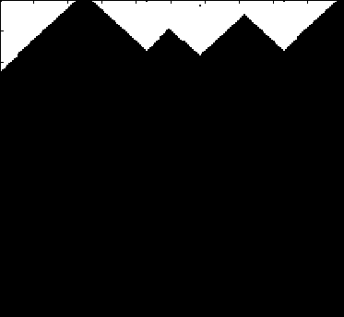
Splash Belief Propagation
Many
Updates
Splash
Synthetic Noisy Image
Few
Updates
Vertex Updates
Algorithm identifies and focuses
on hidden sequential structure
Factor Graph
Notes:
In the denoising task our goal is to estimate the true assignment to every pixel in the synthetic noisy image in the top left using the standard grid graphical model shown in the bottom right. In the video <click> brighter pixels have been updated more often than darker pixels. Initially the algorithm constructs large rectangular Splashes. However, as the execution proceeds the algorithm quickly identifies and focuses on hidden sequential structure along the boundary of the rings in the synthetic noisy image.
So far we have provided the pieces of a parallel algorithm. To make this a distributed parallel algorithm we must now address the challenges of distributed state. <click>

Slide 37
Evaluation
System Design
Multicore and distributed implementations
Development was time consuming
Evaluated on several real-world problems
Protein interaction and structure prediction
Markov Logic Networks
Compared against several other variants
Faster, more efficient, more stable

Slide 38
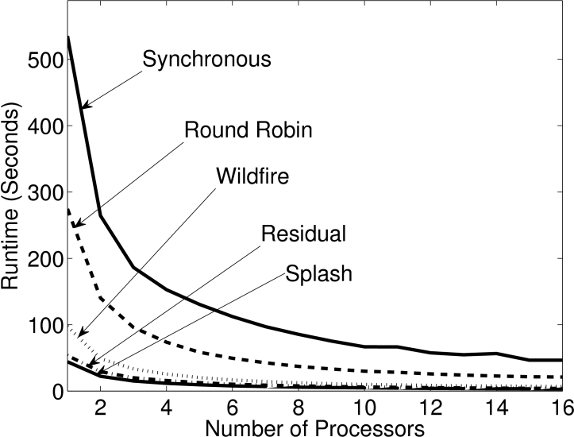
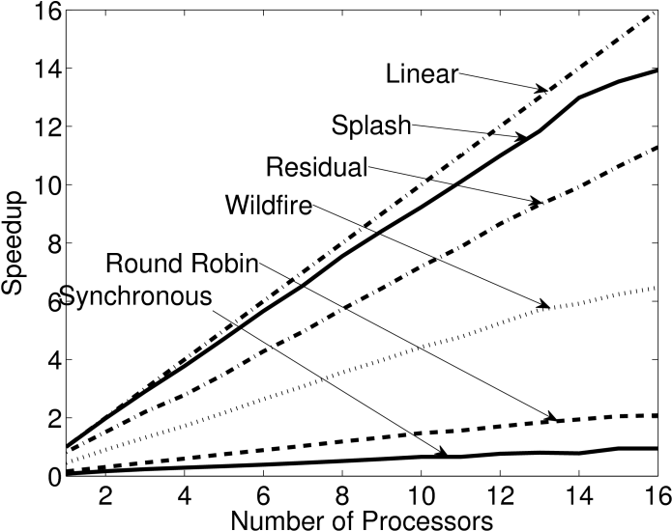
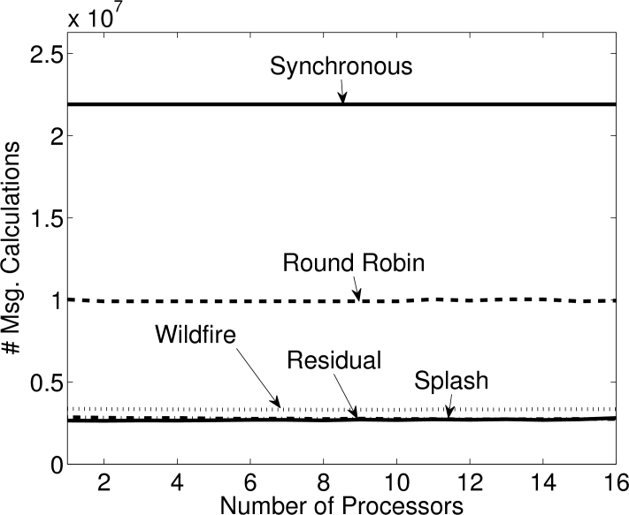
Representative Results
Protein Interaction Models: 14K Vertices, 21K Factors
Runtime
Speedup
Total Work
Synchronous
Theoretical Optimal
Splash
Faster
Synchronous
More Efficient
Better Scaling
Splash
Splash
Synchronous
SplashBP converges more often
Achieves better prediction accuracy

Slide 39
Summary: Belief Propagation
Asynchronous + Dynamic → more efficient
Theoretically and experimentally
Insight: parallelize optimal sequential algorithm
Tradeoff: Parallelism & Convergence
Approximation → Increased Parallelism
Exploit weak interactions (τ_{ε} – approximation)
Key Contributions:
Demonstrate the importance of dynamic asynchronous scheduling in parallel inference
Theoretical analysis of work efficiency and relationship to model structure and parameters

Slide 40
GrAD Methodology
Graphical
BP updates only depend on adjacent vertices
Asynchronous
Compute messages sequentially within Splash
Dynamic
Priority scheduling and adaptive Splashes

Slide 41
Additional Related Work
Sequential
Parallel
TRP: Wainwright et al. IEEE Inf. Thr. ‘03
Wildfire: Ranganathan et al. IJCAI’07
ResidaulBP: Elidan et al. UAI’06
Synchronous Asynchronous Async. + Dynamic
Sun et al. ECCV’02
Brunton et al. CRV’06
Mendiburu et al. GECC’07
Kang et al. LDMTA’10
Thesis Work Parallel and Distributed
WildfireBP, ResidualBP, & SplashBP
Parallel Exact Inference: Pennock et al. UAI’98
Approximate Messages: Ihler et al. JMLR’05

Slide 42
Parallel and Distributed Algorithms
for Probabilistic Inference
Belief Propagation
Gibbs Sampling

Slide 43
Parallel Gibbs Sampling
An asynchronous Gibbs Sampler that dynamically addresses strong dependencies.
Joint Work With
Yucheng Low Arthur Gretton Carlos Guestrin
Published
AISTATS’11 (Related to work in WSDM’12)

Slide 44
Gibbs Sampling [Geman & Geman, 1984]
Sequentially for each variable in the model
Select variable
Use adjacent assignments to construct a biased coin
Flip coin and update assignment to variable
Initial Assignment
Notes:
Belief propagation is a message passing algorithm in which messages are sent <click> from variable to factor and then <click> from factor to variable and the processes is repeated. At each phase the new messages are computed using the old message from the previous phase leading to a naturally parallel algorithm known as synchronous Belief Propagation.

Slide 45
Can we sample multiple variables in parallel?

Slide 46
From the original paper on Gibbs Sampling:
“…the MRF can be divided into collections of [variables] with each collection assigned to an independently running asynchronous processor.”
-- Stuart and Donald Geman, 1984.
Embarrassingly
Parallel!
Converges to the wrong distribution!

Slide 47
The problem with Synchronous Gibbs sampling
t=1
t=2
t=3
Strong Positive
Correlation
t=0
Sequential
Execution
Strong Positive
Correlation
Heads:
Tails:
Strong Negative
Correlation
Parallel
Execution
Adjacent variables cannot be sampled simultaneously.

Slide 48
Introduced Three Convergent Samplers
Chromatic: Use graph coloring to synchronously sample independent sets
Asynchronous: Markov Blanket Locks ensure serializable execution
Splash: Adaptively constructs thin junction tree blocks

Slide 49


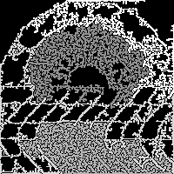
Dynamically Prioritized Sampling
Prioritize Gibbs updates
Adapt the shape of the Splash to span strongly coupled variables:
Noisy Image
BFS Splashes
Adaptive Splashes

Slide 50
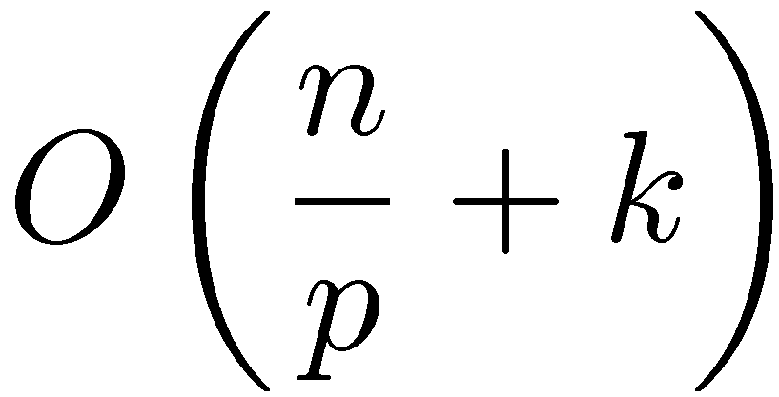
Theorem: Chromatic Sampler
Ergodic: converges to the correct distribution
Based on graph coloring of the Markov Random Field
Quantifiable acceleration in mixing
Time to update all variables once
# Variables
# Colors
# Processors

Slide 51
Theorem Asynchronous and Splash Gibbs Sampler
Ergodic: converges to the correct distribution
Requires vanishing adaptation
Corrected an error in a result by Levin & Casella J. Multivar. Anal. ’06
Expected Parallelism:
Max Degree
# Processors
# Variables

Slide 52
Evaluation
Implemented multicore version:
Built using a GraphLab prototype
Substantially shorter development time
Novel junction tree construction algorithm
Markov blanket locking protocol
Evaluated on large real-world problems

Slide 53
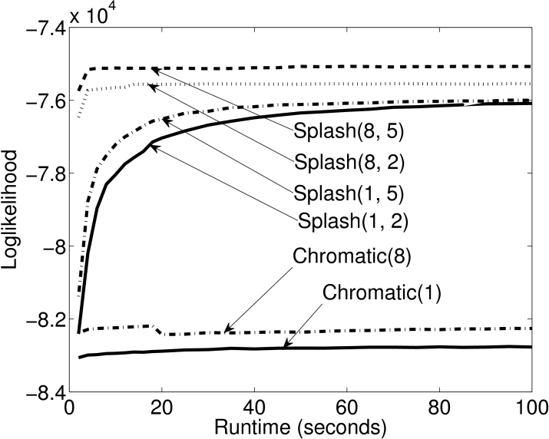
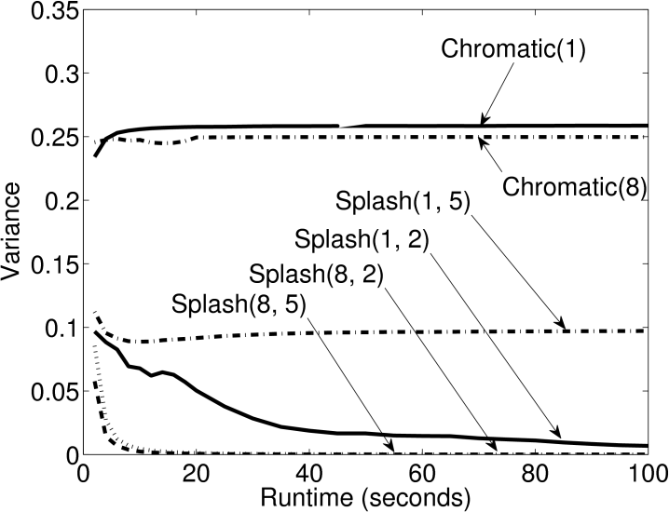
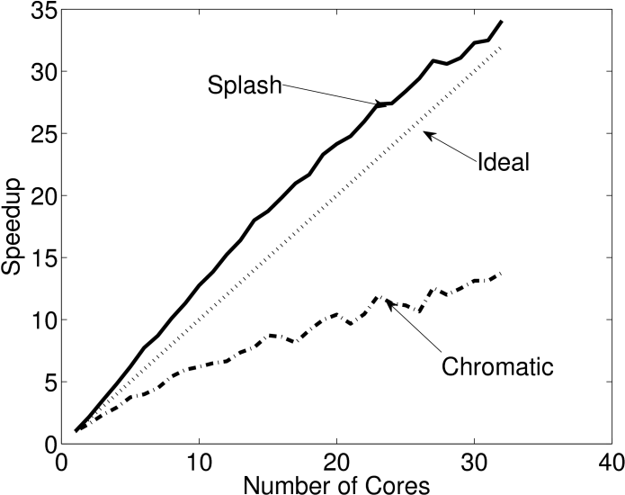
Experimental Results
Markov logic network with strong dependencies
10K Variables 28K Factors
Likelihood
Final Sample
Speedup in Sample Generation
“Mixing”
Splash
Splash
Better
Chromatic
Better
Chromatic
Better
Chromatic
Splash
The Splash sampler outperforms the Chromatic sampler on models with strong dependencies

Slide 54
Contributions: Gibbs Sampling
Proposed three convergent Gibbs samplers
Chromatic, Asynchronous, Splash
Spectrum partially synchronous to asynchronous
New algorithms for junction tree construction
Theoretical analysis of parallel Gibbs sampling
Convergence of asynchronous blocking
Relate parallelism to model structure
Stationary distribution of synchronous sampler
Experimental analysis on real-world problems and systems

Slide 55
GrAD Methodology
Graphical
Gibbs updates depend only on neighbors in MRF
Asynchronous
Graph Coloring and Markov Blanket Locks
Dynamic
Prioritized updates and adaptive Splash

Slide 56
Related Work
Ergodic (Convergent)
Thesis
Chromatic,
Asynchronous,
and
Splash Gibbs
Parallel &
Distributed
Geman & Geman. Pami ’84
Trees: Hamze et al. UAI’04
Dynamic Blocking: Barbu et al. IEEE Trans Pattern Analysis ‘05
LDA & Bayesian Networks
Newman et al. NIPS’07
Asuncion et al. NIPS’08
Yan et al. NIPS’09
Amr et al. WSDM’12
Asynchronous approximations empirically perform well

Slide 57
Massive Structured Problems
Probabilistic Graphical Models
Parallel and Distributed Algorithms
for Probabilistic Inference
GraphLab & PowerGraph
Advances Parallel Hardware

Slide 58
Parallel Algorithms for Probabilistic Inference
GraphLab & PowerGraph
Parallel Hardware
Joint Work With
Yucheng Low Aapo Kyrola Haijie Gu Danny Bickson
Carlos Guestrin Joe Hellerstein Guy Blelloch David O’Hallaron
Published Results
UAI’10 VLDB’12

Slide 59
How do we design and implement GrAD Algorithms
We could:
design and implement for each architecture?
Time consuming
Repeatedly solving the same system problems
use high-level abstractions like MapReduce?
Unable to express:
Graphical
Asynchronous
Dynamic
Solution: GraphLab
GrAD Methodology

Slide 60
GraphLab is a Graph-Parallel Abstraction
Data-Parallel Graph-Parallel
Map Reduce
GraphLab
Independent Data
Single Pass
Synchronous
Graph Structured Data
Iterative Computation
Dynamic + Asynchronous

Slide 61
The GraphLab Abstraction
A user-defined Vertex Program runs on each vertex
Graph constrains interaction along edges
Directly read and modify the state of adjacent vertices and edges
Parallelism: run multiple vertex programs simultaneously

Slide 62
The GraphLab Vertex Program
Vertex Programs directly access adjacent vertices and edges
GraphLab_PageRank(i)
// Compute sum over neighbors
total = 0
foreach( j in neighbors(i)):
total = total + R[j] * w_{ji}
// Update the PageRank
R[i] = total
// Trigger neighbors to run again
priority = |R[i] – oldR[i]|
if R[i] not converged then
signal neighbors(i) with priority
R[4] * w₄₁
4
+
1
R[3] * w₃₁
R[2] * w₂₁
+
3
2
Dynamics

Slide 63
GraphLab is Asynchronous
The scheduler determines the order that vertices are executed
CPU 1
b
c
d
a
b
c
Scheduler
e
f
b
e
f
g
a
i
h
i
j
h
i
j
k
CPU 2
Scheduler can prioritize vertices.

Slide 64
GraphLab is Serializable
Conflict
Edge
Conflict
Edge
Automatically ensures serializable executions

Slide 65
Serializable Execution
For each parallel execution, there exists a sequential execution of vertex-programs which produces the same result.
CPU 1
time
Parallel
CPU 2
Sequential
Single
CPU

Slide 66
The GraphLab System
Implemented as a C++ API
Widely downloaded open-source project
Multicore and distributed versions:
Hide Latency: Pipelined locking
Fault Tolerance: Chandy-Lamport Snapshot
Tested on a wide range of ML algorithms
ALS, BP, Gibbs, Lasso, CoEM, SVM, LDA, …

Slide 67
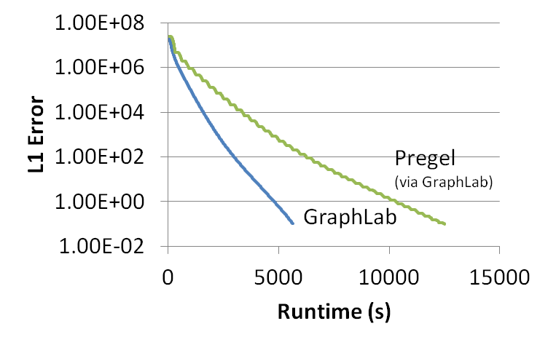
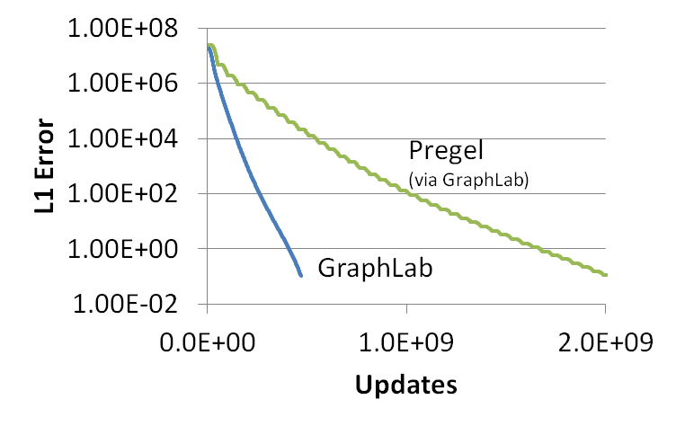
GraphLab vs. Pregel (BSP)
Better
51% updated only once!
PageRank (25M Vertices, 355M Edges)

Slide 68
Never Ending Learner Project (CoEM)
Better
Optimal
Hadoop (BSP) | 95 Cores | 7.5 hrs
GraphLab | 16 Cores | 30 min
GraphLab CoEM
Distributed GraphLab | 32 EC2 machines | 80 secs
6x fewer CPUs!
15x Faster!
0.3% of Hadoop time

Slide 69
Summary: GraphLab
Generalizes the GrAD Methodology
ALS, BP, Gibbs, Lasso, CoEM, SVM, PageRank, LDA, …
Simplifies the design and implementation of GrAD Algorithms
Substantially outperforms existing systems
Key Contributions:
Formalized the graph-parallel setting
Isolates computation from movement of data
Strong serializability guarantees
Evaluation on a wide range of algorithms

Slide 70
GraphLab provided exciting scaling performance
Thus far…
But…
We couldn’t scale up to
Altavista Webgraph from 2002
1.4B vertices, 6.6B edges

Slide 71
Parallel Algorithms for Probabilistic Inference
GraphLab & PowerGraph
Parallel Hardware
Joint Work With
Yucheng Low Aapo Kyrola Haijie Gu Danny Bickson
Carlos Guestrin Joe Hellerstein Guy Blelloch David O’Hallaron
Published Results
OSDI’12

Slide 72


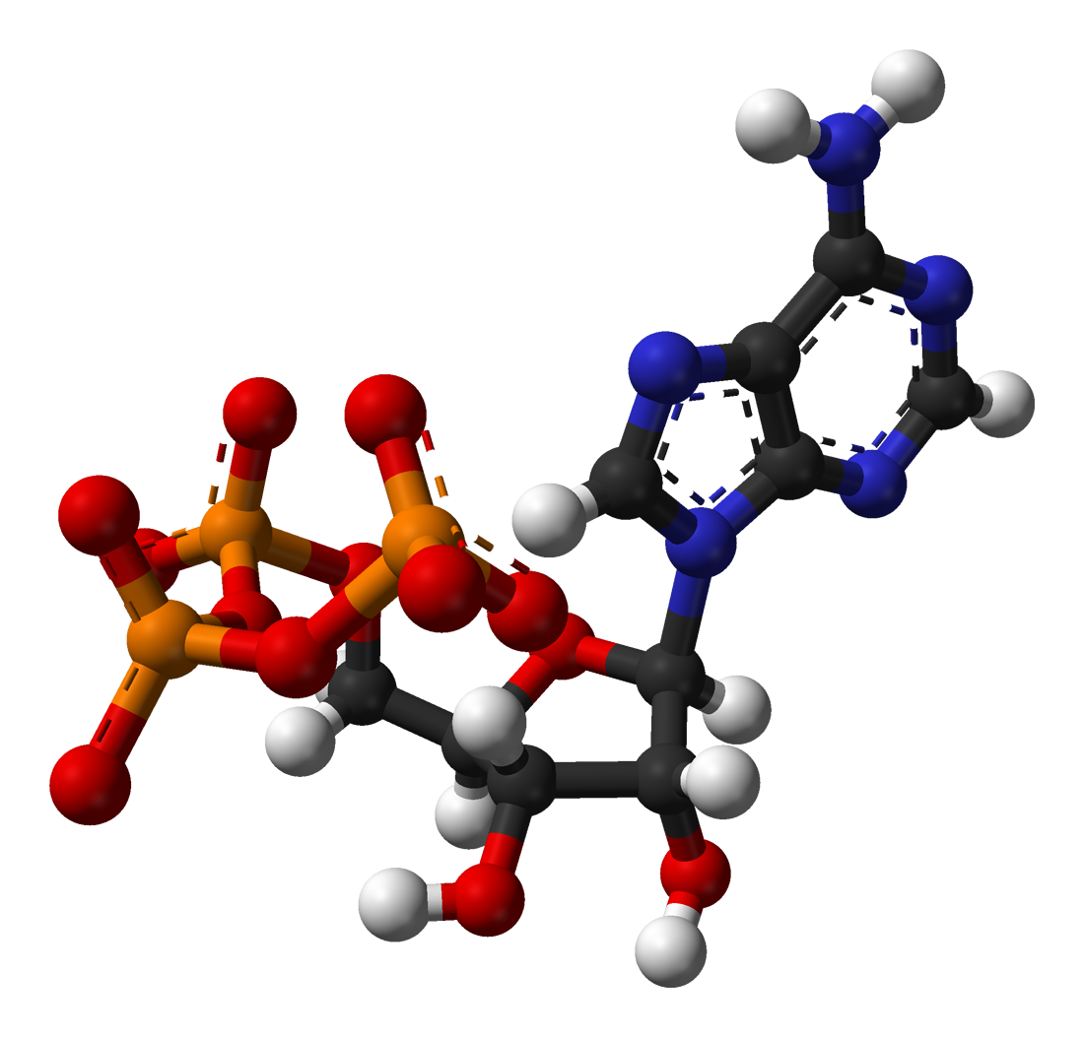




Natural Graphs Graphs derived from natural phenomena

Slide 73
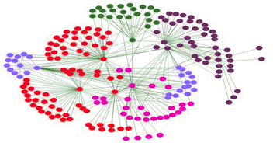
Properties of Natural Graphs
Regular Mesh
Natural Graph
Power-Law Degree Distribution

Slide 74
Power-Law Degree Distribution
More than 10⁸ vertices have one neighbor.
High-Degree
Vertices
Top 1% of vertices are adjacent to
50% of the edges!
-Slope = α ≈ 2
Number of Vertices
AltaVista WebGraph
1.4B Vertices, 6.6B Edges
Degree

Slide 75

Power-Law Degree Distribution
“Star Like” Motif
President
Obama
Followers

Slide 76

Challenges of High-Degree Vertices
Sequentially process edges
Touches a large
fraction of graph
Edge meta-data too large for single machine
Serializability Requires
Heavy Locking

Slide 77
Graph Partitioning
Graph parallel abstractions rely on partitioning:
Minimize communication
Balance computation and storage
Machine 1
Machine 2
Comm. Cost O(# cut edges)

Slide 78
Power-Law Graphs are Difficult to Partition
CPU 1
CPU 2
Power-Law graphs do not have low-cost balanced cuts [Leskovec et al. 08, Lang 04]
Traditional graph-partitioning algorithms perform poorly on Power-Law Graphs. [Abou-Rjeili et al. 06]

Slide 79
Random Partitioning
GraphLab resorts to random (hashed) partitioning on natural graphs
Machine 1
Machine 2
10 Machines → 90% of edges cut
100 Machines → 99% of edges cut!

Slide 80
In Summary
GraphLab is not well suited for natural graphs
CPU 1
CPU 2
Challenges of high-degree vertices
Low quality partitioning

Slide 81
PowerGraph
Program
For This
Run on This
Machine 1
Machine 2
Split High-Degree vertices
New Abstraction → Equivalence on Split Vertices

Slide 82
A Common Pattern for Vertex-Programs
GraphLab_PageRank(i)
// Compute sum over neighbors
total = 0
foreach( j in neighbors(i)):
total = total + R[j] * w_{ji}
// Update the PageRank
R[i] = total
// Trigger neighbors to run again
priority = |R[i] – oldR[i]|
if R[i] not converged then
signal neighbors(i) with priority
Gather Information About Neighborhood
Update Vertex
Signal Neighbors &
Modify Edge Data

Slide 83
GAS Decomposition
Machine 1
Machine 2
Master
Gather
Y’
Y’
Y’
Y’
Σ₁
Σ
Σ₂
+ + +
Mirror
Apply
Y
Y
Y
Y
Machine 3
Machine 4
Scatter
Σ₃
Σ₄
Mirror
Mirror

Slide 84
Minimizing Communication in PowerGraph
Communication is linear in the number of machines each vertex spans
New Theorem: For any edge-cut we can directly construct a vertex-cut which requires strictly less communication and storage.
Y
Y
Y
A vertex-cut minimizes machines each vertex spans
Percolation theory suggests that power law graphs have good vertex cuts. [Albert et al. 2000]

Slide 85
Constructing Vertex-Cuts
Evenly assign edges to machines
Minimize machines spanned by each vertex
Assign each edge as it is loaded
Touch each edge only once
Propose two distributed approaches:
Random Vertex Cut
Greedy Vertex Cut

Slide 86
Random Vertex-Cut
Randomly assign edges to machines
Machine 1
Machine 2
Machine 3
Balanced Vertex-Cut
Y
Spans 3 Machines
Y
Y
Y
Y
Y
Z
Y
Z
Y
Y
Y
Z
Z
Spans 2 Machines
Not cut!

Slide 87
Random Vertex-Cuts vs. Edge-Cuts
Expected improvement from vertex-cuts:
Order of Magnitude
Improvement

Slide 88
Greedy Vertex-Cuts
Place edges on machines which already have the vertices in that edge.
Machine1
Machine 2
A
B
B
C
A
B
D
E

Slide 89
Greedy Vertex-Cuts Improve Performance
Greedy partitioning improves computation performance.

Slide 90
System Design
PowerGraph (GraphLab2) System
MPI/TCP-IP
PThreads
HDFS
EC2 HPC Nodes
Implemented as C++ API
Uses HDFS for Graph Input and Output
Fault-tolerance is achieved by check-pointing
Snapshot time < 5 seconds for twitter network

Slide 91
PageRank on the Twitter Follower Graph
Natural Graph with 40M Users, 1.4 Billion Links
Communication
Runtime
Total Network (GB)
Seconds
PowerGraph
PowerGraph
Reduces Communication
Runs Faster
32 Nodes x 8 Cores (EC2 HPC cc1.4x)

Slide 92


PowerGraph is Scalable
Yahoo Altavista Web Graph (2002):
One of the largest publicly available web graphs
1.4 Billion Webpages, 6.6 Billion Links
7 Seconds per Iter.
1B links processed per second
30 lines of user code
64 HPC Nodes
1024 Cores (2048 HT)

Slide 93
Topic Modeling
English language Wikipedia
2.6M Documents, 8.3M Words, 500M Tokens
Computationally intensive algorithm
100 Yahoo! Machines
Specifically engineered for this task
64 cc2.8xlarge EC2 Nodes
200 lines of code & 4 human hours
PowerGraph

Slide 94
Triangle Counting on The Twitter Graph
Identify individuals with strong communities.
Counted: 34.8 Billion Triangles
Hadoop [WWW’11]
1536 Machines
423 Minutes
64 Machines
1.5 Minutes
282 x Faster
PowerGraph
Why? Wrong Abstraction → Broadcast O(degree²) messages per Vertex
S. Suri and S. Vassilvitskii, “Counting triangles and the curse of the last reducer,” WWW’11
Notes:
S. Suri and S. Vassilvitskii, “Counting triangles and the curse of the last reducer,” presented at the WWW '11: Proceedings of the 20th international conference on World wide web, 2011.

Slide 95
Machine Learning and Data-Mining Toolkits
Graph Analytics
Graphical Models
Computer Vision
Clustering
Topic Modeling
Collaborative Filtering
PowerGraph (GraphLab2) System
Demonstrates the Applicability
of the GrAD Methodology

Slide 96
Summary: PowerGraph
Identify the challenges of Natural Graphs
High-degree vertices, Low-quality edge-cuts
Solution PowerGraph System
GAS Decomposition: split vertex programs
Vertex-partitioning: distribute natural graphs
PowerGraph theoretically and experimentally outperforms existing graph-parallel systems.

Slide 97

Related High-Level Abstractions
Synchronous
GrAD
Pregel
PowerGraph
[Dean et al. OSDI’04]
Messaging
[PODC’09, SIGMOD’10]
Shared State
[UAI’10, VLDB’12, OSDI’12]
Data-Parallel Graph-Parallel
Others
Spark, Twister, …
Others
Giraph, Golden Orbs, GPS, BoostPGL, …
Others
Signal-Collect, GraphChi

Slide 98
Massive Structured Problems
Probabilistic Graphical Models
Parallel and Distributed Algorithms
for Probabilistic Inference
GraphLab & PowerGraph
Advances Parallel Hardware

Slide 99
Thesis Statment
Efficient parallel and distributed systems for probabilistic reasoning follow the GrAD Methodology
Graphically decomposition:
Expose parallelism and distribute state
Asynchronous scheduling
Improved convergence and correctness
Dynamic prioritization
Eliminated wasted work

Slide 100
Observations
Graphical models encode statistical, computational, and parallel structure
Tradeoff: Convergence and Parallelism
Many things can be computed in parallel
Not all parallel computation is productive
Approximation →Increased Parallelism
τ_{ε}-approximation, approximate sampling
Power of high-level abstractions
Enables the exploration of GrAD methodology

Slide 101
Future: Declarative Models
Models are recursive relationships
BP, Gibbs Sampling, PageRank, …
System determines the optimal schedule
My Interests
Sum of my friends interests
“Closeness”
number of overlapping posts

Slide 102
Future: Online Probabilistic Reasoning
The world is rapidly evolving:
Make friends and rate movies in real-time
How do we define and maintain models?
Declarative specification: time invariant
τ_{ε}-approximation: small change → local effect
Exploit Power-Law structure in change
Popular items are rated more frequently
Exploit burstiness for better caching

Slide 103
Contributions & Broader Impact
Theoretically and experimentally characterized
Importance of dynamic asynchronous scheduling
Effect of model structure and parameters on parallelism
Effect of approximation accuracy on parallelism
Tradeoff between parallelism and convergence
Developed two graph-parallel abstractions
GraphLab: vertex-centric view of computation
PowerGraph: Distributed vertex-centric view of computation
Fostered a community around GraphLab/PowerGraph
Substantial industry and academic interest
Built a foundation for the future design of scalable systems for probabilistic reasoning

Slide 104
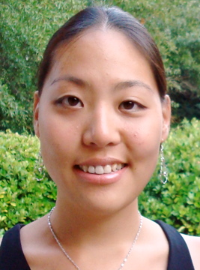




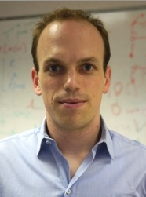
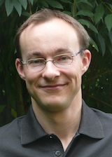


Thank You!
Sue Ann
Hong
Yucheng
Low
Aapo
Kyrola
Haijie
Gu
Danny
Bickson
Arthur
Gretton
Andreas
Krause
Carlos
Guestrin
Alex
Smola
Jeff
Bilmes
David
O’Hallaron
Guy
Blelloch
Joe
Hellerstein
The Select Lab & My Family

